Slide 1
Introduction to XML

Slide 2
XML
An Extensible Markup Language (XML) document describes the structure of data
XML and HTML have a similar syntax … both derived from SGML
XML has no mechanism to specify the format for presenting data to the user
An XML document resides in its own file with an ‘.xml’ extension
XML was designed to transport and store data.
XML tags are not predefined. You must define your own tags
XML is designed to be self-descriptive

Slide 3
XML is not…
A replacement for HTML
(but HTML can be generated from XML)
A presentation format
(but XML can be converted into one)
A programming language
(but it can be used with almost any language)
A network transfer protocol
(but XML may be transferred over a network)
A database
(but XML may be stored into a database)
Notes:
Jsf jsp asp spx

Slide 4
But then – what is it?
XML is a meta markup language for text documents / textual data
XML allows to define languages (“applications”) to represent text documents / textual data

Slide 5
XML by Example
<article>
<author>Gerhard Weikum</author>
<title>The Web in 10 Years</title>
</article>
Easy to understand for human users
Very expressive (semantics along with the data)
Well structured, easy to read and write from programs

Slide 6
XML by Example
… this is XML, too:
<t108>
<x87>Gerhard Weikum</x87>
<g10>The Web in 10 Years</g10>
</t108>
Hard to understand for human users
Not expressive (no semantics along with the data)
Well structured, easy to read and write from programs

Slide 7
XML by Example
… and another example:
<data>
ch37fhgks73j5mv9d63h5mgfkds8d984lgnsmcns983
</data>
Impossible to understand for human users
Not expressive (no semantics along with the data)
Unstructured, read and write only with special programs
The actual benefit of using XML highly depends on the design of the application.

Slide 8
Possible Advantages of Using XML
Truly Portable Data
Easily readable by human users
Very expressive (semantics near data)
Very flexible and customizable (no finite tag set)
Easy to use from programs (libs available)
Easy to convert into other representations
(XML transformation languages)
Many additional standards and tools
Widely used and supported
Notes:
Plateform independent consumer and producer
Java objects
Heriachy
Own tags
Every lang has lib , API that can read
API that can on run time convert xml to pdf (eh HR result, wants before result save n databace,,cant use tag to read,,xml like css uses xml ss ,,,will link with xml… n generate html. (XST)
Query lang, support to store in database, xml schema stlstudio
Soap, docx word .xml an api style sheet xml to word

Slide 9
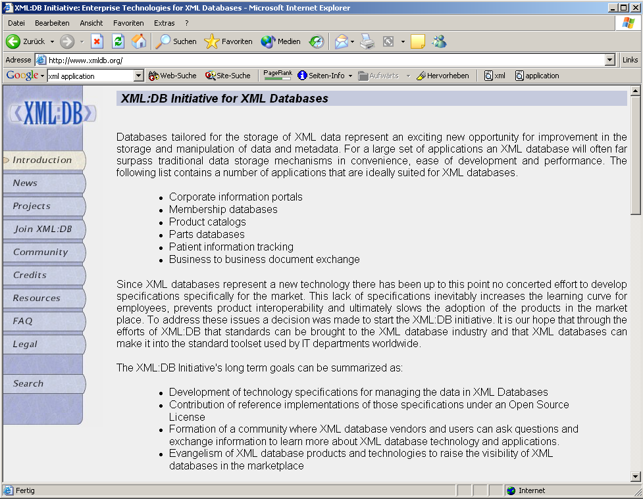



App. Scenario 1: Content Management
Clients
XML2HTML
XML2WML
XML2PDF
Converters
Database with XML documents

Slide 10
App. Scenario 2: Data Exchange
Buyer
Supplier
XML Adapter
XML
XML Adapter
Legacy System (e.g., SAP R/2)
Legacy System (e.g., Cobol)
Order

Slide 11
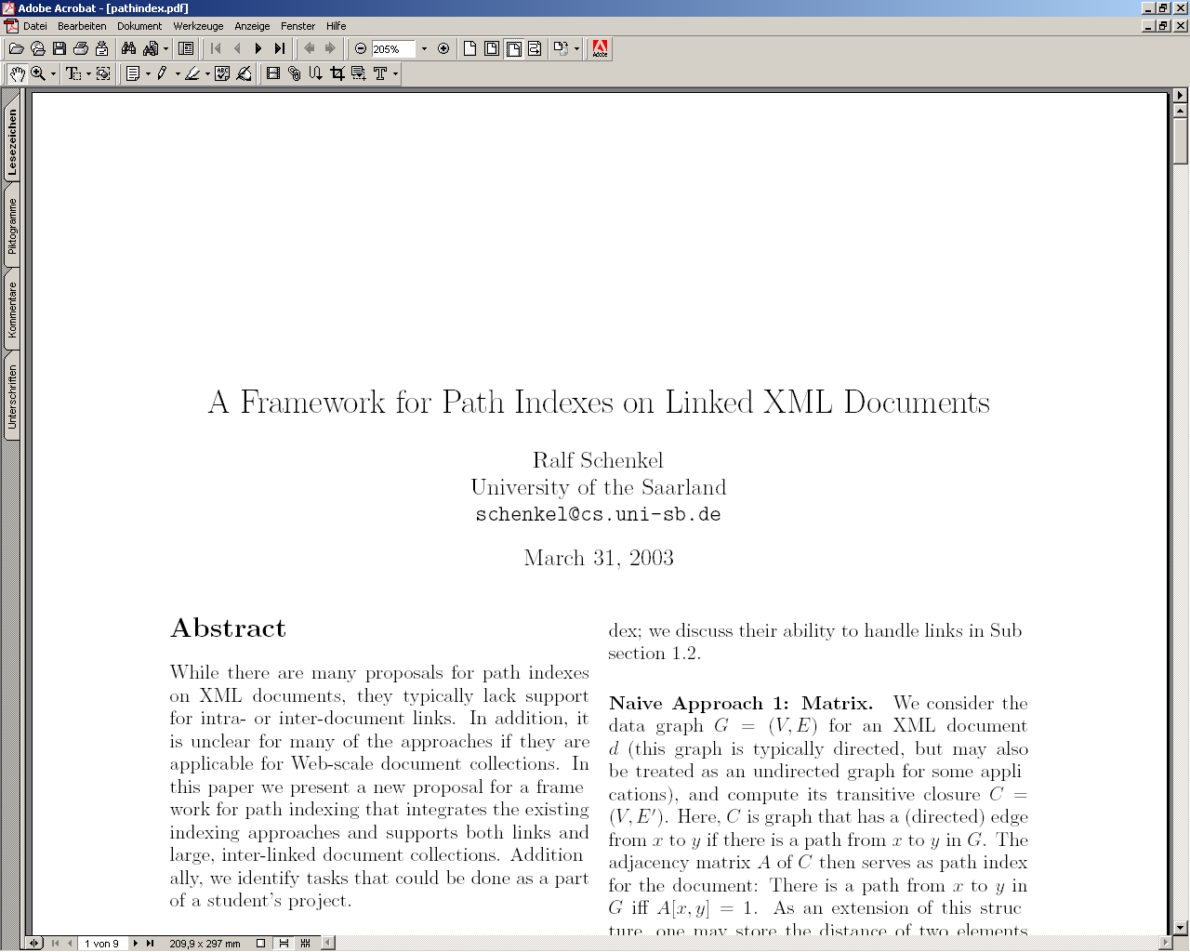
App. Scenario 3: XML for Metadata
<rdf:RDF
<rdf:Description rdf:about="http://www-dbs/Sch03.pdf">
<dc:title>A Framework for…</dc:title>
<dc:creator>Ralf Schenkel</dc:creator>
<dc:description>While there are...</dc:description>
<dc:publisher>Saarland University</dc:publisher>
<dc:subject>XML Indexing</dc:subject>
<dc:rights>Copyright ...</dc:rights>
<dc:type>Electronic Document</dc:type>
<dc:format>text/pdf</dc:format>
<dc:language>en</dc:language>
</rdf:Description>
</rdf:RDF>
Notes:
Define the related information

Slide 12
XML Documents
What‘s in an XML document?
Elements
Attributes
plus some other details

Slide 13
A Simple XML Document
<?xml version="1.0"?>
<shipOrder>
<shipTo Pri= “Urgent” >
<name> Svendson </name>
<street> Oslo St </street>
<address> 400 Main </address>
<country> Norway </country>
</shipTo>
</shipOrder>

Slide 14
A Simple XML Document
Freely definable tags
<?xml version="1.0"?>
<shipOrder>
<shipTo Pri= “Urgent” >
<name> Svendson </name>
<street> Oslo St </street>
<address> 400 Main </address>
<country> Norway </country>
</shipTo>
</shipOrder>

Slide 15
A Simple XML Document
<?xml version="1.0"?>
<shipOrder >
<shipTo Pri= “Urgent” >
<name> Svendson </name>
<street> Oslo St </street>
<address> 400 Main </address>
<country> Norway </country>
</shipTo>
</shipOrder>
Start Tag
Content of the Element (Subelements and/or Text)
End Tag
Element

Slide 16
A Simple XML Document
<?xml version="1.0"?>
<shipOrder >
<shipTo Pri= “Urgent” >
<name> Svendson </name>
<street> Oslo St </street>
<address> 400 Main </address>
<country> Norway </country>
</shipTo>
</shipOrder>
Attribute with name and value

Slide 17
Elements in XML Documents
(Freely definable) tags: shipOrder, shipTo, name
  with start tag: <name> etc.
  and end tag: </name> etc.
Elements: <shipTo> ... </shipTo>
Elements have a name (shipOrder) and a content (...)
Elements may be nested.
Elements may be empty: <this_is_empty/>
Element content is typically parsed character data (PCDATA), i.e., strings with special characters, and/or nested elements (mixed content if both).
Each XML document has exactly one root element and forms a tree.
Elements with a common parent are ordered.

Slide 18
Elements vs. Attributes
Elements may have attributes (in the start tag) that have a name and a value, e.g. <shipOrder ID=“O97“>.
What is the difference between elements and attributes?
  Only one attribute with a given name per element (but an arbitrary number of subelements)
  Attributes have no structure, simply strings (while elements can have subelements)
As a rule of thumb:
  Content into elements
  Metadata into attributes
Example:
  <person born=“1912-06-23“ died=“1954-06-07“>
  Alan Turing</person>
Notes:
Primary key or identifier as metadate

Slide 19
XML Documents as Ordered Trees
shipOrder
ID
shipTo
name
street
address
address
O97
Svendson
Oslo St
400 Main
Norway

Slide 20
More on XML Syntax
Some special characters must be escaped using entities:
< → &lt;
& → &amp;
(will be converted back when reading the XML doc)
Some other characters may be escaped, too:
> → &gt;
“ → &quot;
‘ → &apos;

Slide 21
Well-Formed XML Documents
A well-formed document must adher to the following basic rules:
Every start tag has a matching end tag.
Elements may nest, but must not overlap.
There must be exactly one root element.
Attribute values must be quoted.
An element may not have two attributes with the same name.
Comments and processing instructions may not appear inside tags.
No unescaped < or & signs may occur inside character data.
Only well-formed documents can be processed by XML parsers.

Slide 22
Another Example
<article>
<author>Gerhard Weikum</author>
<title>The Web in Ten Years</title>
<text>
<abstract>In order to evolve...</abstract>
<section number=“1” title=“Introduction”>
The <index>Web</index> provides the universal...
</section>
</text>
</article>

Slide 23
Ordered Trees
article
author
title
text
number=“1“
abstract
section
Gerhard Weikum
title=“…“
In order …
The
index
provides …
The Web in 10 years
Web

Slide 24
XML Namespaces
The purpose of XML Namespaces is to distinguish
between duplicate element and attribute names.
For example:
<vehicles>
<sedans><price>$</price></sedans>
<trucks><price>$</price></trucks>
</vehicles>
Since both “sedans” and “trucks” have the same element “price”
element, we use XML Namespaces to distinguish them.

Slide 25
Definition
Namespace is a mapping between an element prefix and a URI
The namespace is defined by the xmlns attribute in the start tag of an element.
The namespace declaration has the following syntax. xmlns:prefix="URI".
  <sedan:price xmlns:sedan=“URI”>
URIs may not be a pointer to information about the Namespace.
They are just unique identifiers. You cannot resolve XML namespace URIs.
Notes:
Uri – uniform resource indicator

Slide 26
Namespace Syntax
<sedan:price xmlns:sedan=“www.ww-sdn/sdn”>
Prefix as abbrevation of URI
Unique URI to identify the namespace
Signal that namespace definition happens

Slide 27
Namespace Example
<?xml version="1.0"?>
<shipOrder >
<erp:shipTo xmlns:erp=“http://www-erp/erp“ >
<erp:name> Svendson </erp:name>
<erp:street> Oslo St </erp:street>
<erp:address> 400 Main </erp:address>
<erp:country> Norway </erp:country>
</erp:shipTo>
<ord:items xmlns:ord=“http://www-ord/ord“ >
<ord:item>
<ord:name> Wheel </ord:name>
<ord:quantity> 1 </ord:quantity>
<ord:price> 10.90 </ord:price>
</ord:item>
<ord:item>
<ord:name> Cam </ord:name>
<ord:quantity> 1 </ord:quantity>
<ord:price> 9.90 </ord:price>
</ord:item>
</ord:items>
</shipOrder>
<dbs:book xmlns:dbs=“http://www-dbs/dbs“>
<dbs:description> ... </dbs:description>
<dbs:text>
<dbs:formula>
<mathml:math xmlns:mathml=“http://www.w3.org/1998/Math/MathML“>
...
</mathml:math>
</dbs:formula>
</dbs:text>
</dbs:book>

Slide 28
Simplified Declaration
Specify all Namespaces within the root element. The specification given for the that element is also valid for all elements occurring inside it.
<?xml version="1.0"?>
<shipOrder xmlns:erp=“http://www-erp/erp“ xmlns:ord=“http://www-ord/ord“ >
<erp:shipTo erp:Pri= “Urgent” >
<erp:name> Svendson </erp:name>
<erp:street> Oslo St </erp:street>
<erp:address> 400 Main </erp:address>
<erp:country> Norway </erp:country>
</erp:shipTo>
<ord:items >
<ord:item>
<ord:title> Wheel </ord:title>
<ord:quantity> 1 </ord:quantity>
<ord:price> 10.90 </ord:price>
</ord:item>
<ord:item>
<ord:title> Cam </ord:title>
<ord:quantity> 1 </ord:quantity>
<ord:price> 9.90 </ord:price>
</ord:item>
</ord:items>
</shipOrder>

Slide 29
Querying XML Data

Slide 30
Querying XML with XPath and XQuery
XPath and XQuery are query languages for XML data, both standardized by the W3C and supported by various database products.
Their search capabilities include logical conditions over element and attribute content and regular expressions for pattern matching of element names along paths or subtrees within XML data + joins, grouping, aggregation, transformation, etc. (XQuery only)
In contrast to database query languages like SQL an XML query does not necessarily (need to) know a fixed structural schema for the underlying data.
A query result is a set of qualifying nodes, paths, subtrees, or a set of XML documents constructed from this raw result.

Slide 31
XPath
XPath is a simple language to identify parts of the XML document (for further processing)
XPath operates on the tree representation of the document
Result of an XPath expression is a set of elements or attributes

Slide 32
Sample XML Document
<?xml version="1.0"?>
<FitnessCenter>
<Member>
<Name> Jeff </Name>
<FavoriteColor> lightgrey </FavoriteColor>
</Member>
<Member>
<Name> David </Name>
<FavoriteColor> lightblue </FavoriteColor>
</Member>
<Member>
<Name> Roger </Name>
<FavoriteColor> lightyellow </FavoriteColor>
</Member>
</FitnessCenter>

Slide 33
<?xml version="1.0"?>
<FitnessCenter>
<Member>
<Name>Jeff</Name>
<FavoriteColor>lightgrey</FavoriteColor>
</Member>
<Member>
<Name>David</Name>
<FavoriteColor>lightblue</FavoriteColor>
</Member>
<Member>
<Name>Roger</Name>
<FavoriteColor>lightyellow</FavoriteColor>
</Member>
</FitnessCenter>
XML document represented as a tree
Document
/
PI
<?xml version=“1.0”?>
Element
FitnessCenter
Element
Member
Element
Member
Element
Member
Element
Name
Element
FavoriteColor
Element
Name
Element
FavoriteColor
Element
Name
Element
FavoriteColor
Text
Jeff
Text
lightgrey
Text
David
Text
lightblue
Text
Roger
Text
lightyellow

Slide 34
Xpath – Concepts
Terminology - node
Processing Instruction (PI) node
Document node
Document
/
Element nodes
PI
<?xml version=“1.0”?>
Element
FitnessCenter
Text nodes
Element
Member
Element
Member
Element
Member
Element
Name
Element
FavoriteColor
Element
Name
Element
FavoriteColor
Element
Name
Element
FavoriteColor
Text
Jeff
Text
lightgrey
Text
David
Text
lightblue
Text
Roger
Text
lightyellow

Slide 35
Xpath - Concepts
Document
/
PI
<?xml version=“1.0”?>
Element
FitnessCenter
With respect to this node, these are its children
Element
Member
Element
Member
Element
Member
Element
Name
Element
FavoriteColor
Element
Name
Element
FavoriteColor
Element
Name
Element
FavoriteColor
Text
Jeff
Text
lightgrey
Text
David
Text
lightblue
Text
Roger
Text
lightyellow

Slide 36
Xpath - Concepts
Document
/
PI
<?xml version=“1.0”?>
Element
FitnessCenter
These are its descendant nodes
Element
Member
Element
Member
Element
Member
Element
Name
Element
FavoriteColor
Element
Name
Element
FavoriteColor
Element
Name
Element
FavoriteColor
Text
Jeff
Text
lightgrey
Text
David
Text
lightblue
Text
Roger
Text
lightyellow

Slide 37
Xpath - Concepts
Document
/
PI
<?xml version=“1.0”?>
Element
FitnessCenter
This is the context node
Element
Member
Element
Member
Element
Member
Element
Name
Element
FavoriteColor
Element
Name
Element
FavoriteColor
Element
Name
Element
FavoriteColor
Text
Jeff
Text
lightgrey
Text
David
Text
lightblue
Text
Roger
Text
lightyellow

Slide 38
Xpath - Concepts
Document
/
PI
<?xml version=“1.0”?>
Element
FitnessCenter
Element
Member
That's
its parent
Element
Member
Element
Member
Element
Name
Element
FavoriteColor
Element
Name
Element
FavoriteColor
Element
Name
Element
FavoriteColor
Text
Jeff
Text
lightgrey
Text
David
Text
lightblue
Text
Roger
Text
lightyellow

Slide 39
Xpath - Concepts
Document
/
PI
<?xml version=“1.0”?>
Element
FitnessCenter
Element
Member
Those are its ancestors
Element
Member
Element
Member
Element
Name
Element
FavoriteColor
Element
Name
Element
FavoriteColor
Element
Name
Element
FavoriteColor
Text
Jeff
Text
lightgrey
Text
David
Text
lightblue
Text
Roger
Text
lightyellow

Slide 40
Xpath - Concepts
Document
/
PI
<?xml version=“1.0”?>
Element
FitnessCenter
Element
Member
It has 2 siblings
Element
Member
Element
Member
Element
Name
Element
FavoriteColor
Element
Name
Element
FavoriteColor
Element
Name
Element
FavoriteColor
Text
Jeff
Text
lightgrey
Text
David
Text
lightblue
Text
Roger
Text
lightyellow

Slide 41
Xpath - Concepts
Document
/
PI
<?xml version=“1.0”?>
Element
FitnessCenter
Element
Member
They are following-siblings
Element
Member
Element
Member
Element
Name
Element
FavoriteColor
Element
Name
Element
FavoriteColor
Element
Name
Element
FavoriteColor
Text
Jeff
Text
lightgrey
Text
David
Text
lightblue
Text
Roger
Text
lightyellow

Slide 42
Xpath - Concepts
Document
/
PI
<?xml version=“1.0”?>
Element
FitnessCenter
Element
Member
It has no preceding-siblings
Element
Member
Element
Member
Element
Name
Element
FavoriteColor
Element
Name
Element
FavoriteColor
Element
Name
Element
FavoriteColor
Text
Jeff
Text
lightgrey
Text
David
Text
lightblue
Text
Roger
Text
lightyellow

Slide 43
Elements of XPath
An XPath expression usually is a location path that consists of location steps, separated by /:
  /article/text/abstract: selects all abstract elements
A leading / always means the root element
Each location step is evaluated in the context of a node in the tree, the so-called context node
Possible location steps:
  child element x select all child elements with name x
  Attribute @x select all attributes with name x
  Wildcards * (any child), @* (any attribute)
  Multiple matches, separated by | x|y|z

Slide 44
Combining Location Steps
Standard: / (context node is the result of the preceding location step)
  /article/text/abstract (all the abstract nodes of articles)
Select any descendant, not only children: //
  article//index (any index element in articles)
Select the parent element: ..
Select the content node: .
The latter two are important when using predicates.

Slide 45
Predicates in Location Steps
Added with [] to the location step
Used to restricts elements that qualify as result of a location step to those that fulfil the predicate:
  a[b] elements a that have a subelement b
  a[@d] elements a that have an attribute d
  Plus conditions on content/value:
    a[b=“c“]
    A[@d>7]
    <, <=, >=, !=, …

Slide 46
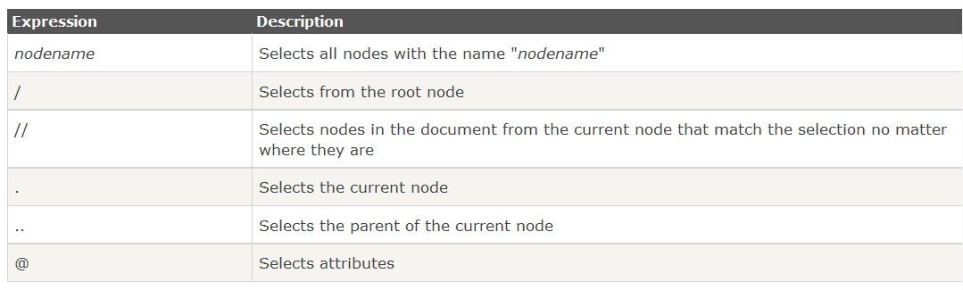
Selecting Nodes

Slide 47
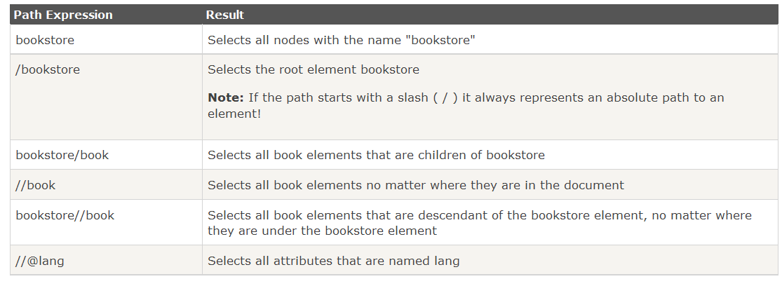
Selecting Nodes

Slide 48
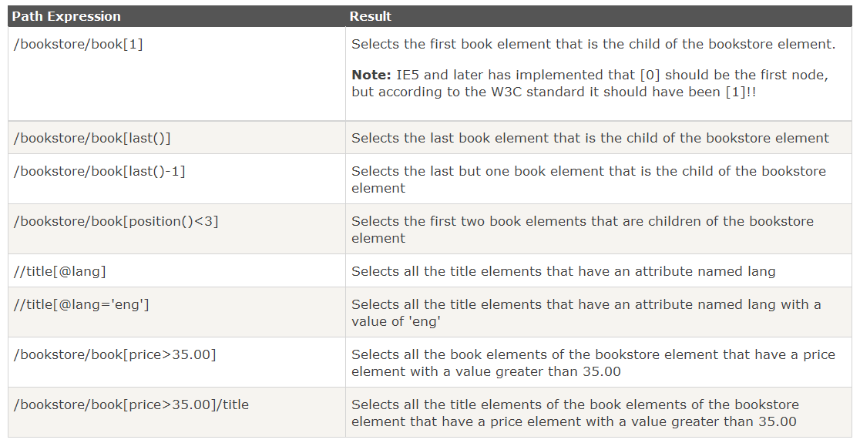
Predicates

Slide 49
A Simple XML Document
<literature>
<book year=“2001”>
<author>
<firstname> Gerhard </firstname>
<lastname> Weikum </lastname>
<country> Germany </country>
</author>
<title>The Web in Ten Years</title>
<price> 50 </price>
<text>
<abstract>In order to evolve...</abstract>
<section number=“1” title=“Introduction”>
The <index>Web</index> provides the universal...
</section>
</text>
</book>
</literature>

Slide 50
XPath by Example
/literature/book/author
retrieves all book authors:
starting with the root, traverses the tree, matches element
names literature, book, author, and returns elements
<author>Suciu</author>,
<author>Abiteboul</author>, ...,
<author> <firstname>Jeff</firstname>
<lastname>Ullman</lastname>
</author>
/literature/(book|article)/author
authors of books or articles
/literature/*/author
authors of books, articles, essays, etc.

Slide 51
XPath by Example
/literature//author
All authors that are in ANY sub element (decendents)
of literature
/literature//@year
value of all year attributes of descendants of literature
/literature//author[firstname]
All authors that have a subelement firstname
/literature/book[price < “50“]
low priced books
All books that have a child element “Price“ with value <50
/literature/book[author//country = “Germany“]
books with German author
All elements “book“ such that their author are from country “Germany“

Slide 52
XML in PHP

Slide 53
SimpleXML Lib
SimpleXML handles the most common XML tasks
It is an easy way of getting an element's attributes and text content
SimpleXML just takes a few lines of code to read text data from an element

Slide 54
Basic Functions
SimpleXML Functions:
simplexml_import_dom — Get a SimpleXMLElement object from a DOM node.
simplexml_load_file — Interprets an XML file into an object
simplexml_load_string — Interprets a string of XML into an object

Slide 55
Simple Application
This application will:
  Load an XML file containing inventory and cost information
  Display each product “item” from the XML file in a nicely formatted HTML table

Slide 56
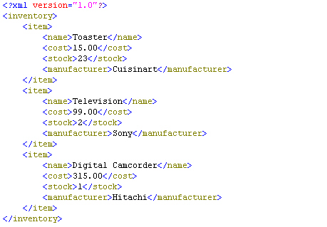
Sample XML File

Slide 57
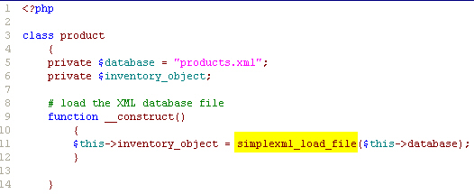
Loading the XML File
Loading the XML file

Slide 58


Displaying the Products
To display products, we can simply iterate through the object using a foreach loop.

Slide 59
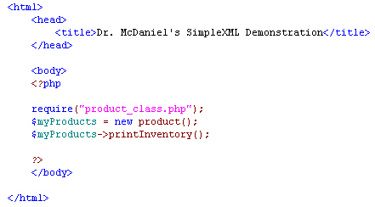
Creating the Product Object

Slide 60
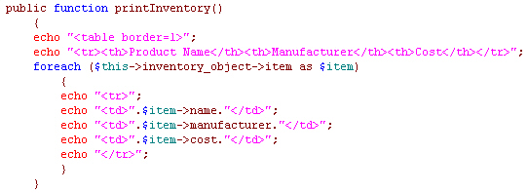
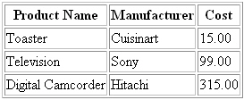
Displaying Additional Details

Slide 61
Document Object Model
We have already seen the Document Object Model (DOM) in the context of JavaScript and HTML
DOM is key to "advanced" XML programming
  It allows you to manipulate XML documents in ways that are not possible using SimpleXML
DOM is language and platform neutral
PHP
Perl
Java
JavaScript
DOM
VB
ASP
C++

Slide 62
What is the DOM?
A set of objects types that are used to represent the object tree view of an XML document
The objects described in the DOM allow to read, search, modify, add to and delete from an XML document
The DOM provides a standard definition of functionality for document navigation and manipulation
A DOM API can be implemented in any programming language
  such implementations are called bindings

Slide 63
DOM Object Types
Main Object Types in DOM
  Node - a general type of object - everything is a node as well as belonging to one of the more specialised types
  Document - to represent the whole document
  Element - to represent each element (i.e. tag)
  Attr - to represent attributes
  Text - a node that represent the textual content of an element
  NodeList - a list of nodes, e.g. all the elements that are "child" elements of another node.
Each object type has a defined set of properties and methods

Slide 64
<?xml version="1.0" ?>
<Menu meal="lunch">
<Starter>
<Dish> Garlic Mushrooms </Dish>
<Dish diet="vegan"> Salad </Dish>
</Starter>
<Main>
<Dish diet="vegan"> Lentil Bake </Dish>
<Dish diet ="vegetarian"> Quorn Surprise </Dish>
</Main>
<Dessert>
<Dish> Ice-cream </Dish>
</Dessert>
</Menu>
XML represented as a DOM tree
Text
Garlic Mushrooms
Element
Dish
Element
Starter
Attr
diet
Element
Dish
Text
Salad
Attr
meal
Attr
diet
Document
Element
Menu
Element
Dish
Element
Main
Text
Lentil Bake
Element
Dish
Attr
diet
Element
Dessert
Element
Dish
Text
Quorn Surprise
Note the addition of a top-level document object
Text
Ice-cream

Slide 65
Exploring DOM
Create DOM Object
Load XML from a file/string
Manipulate DOM Object
  Search/Delete/Create/Replace DOMNode
  Set/Get DOMAttribute
Save DOM Object into a XML file.

Slide 66
Create a DOM Object
Syntax
  DOMDocument::__construct ([ string $version [, string $encoding ]] )
Example
<?php
$dom = new DOMDocument(" 1.0 ", "utf-8 ");
// Dumps the internal XML tree back into a string
echo $dom->saveXML();
?>
Output
  <?xml version="1.0" encoding= "utf-8"?>

Slide 67
Load XML from a file
Syntax
  DOMDocument::load ( string $filename [, int $options = 0 ] )
Example
<?php
$dom = new DOMDocument(" 1.0 ", " utf-8 ");
// load XML from a book.xml
$dom->load(" book.xml ");
echo $dom->saveXML();
?>

Slide 68
Load XML from a string
Syntax
  DOMDocument::loadXML ( string $source [, int $options = 0 ] )
Example
<?php
$dom = new DOMDocument("1.0", "utf-8");
$dom->loadXML("<?xml version='1.0' encoding='utf-8'?>");
echo $dom->saveXML();
?>

Slide 69
Search DOMNode
Syntax
  DOMNodeList DOMElement::getElementsByTagName ( string $name )
  DOMNodeList DOMXPath::query ( string $expression [, DOMNode $contextnode ] )

Slide 70
book.xml
<?xml version="1.0" encoding="utf-8"?>
<books>
<book sn="0001">
<auth>Dai</auth>
<name>Practical Programming in Tcl and Tk</name>
<price>$400</price>
</book>
<book sn="0002">
<auth>Laby</auth>
<name>Programming PHP</name>
<price>$300</price>
</book>
<book sn="0003">
<auth>Hill</auth>
<name>Thinking in Java</name>
<price>$200</price>
</book>
</books>

Slide 71
Example for DOMElement:: getElementsByTagName
<?php
$dom = new DOMDocument("1.0", "utf-8");
$dom->load("book.xml");
$nodes = $dom->getElementsByTagName("book");
foreach($nodes as $n) {
echo $n->getAttribute("sn"). "<br />";
}
?>
Output
0001
0002
0003

Slide 72
Example for DOMXPath::query
<?php
$dom = new DOMDocument("1.0", "utf-8");
$dom->load("book.xml");
$xpath = new DOMXPath($dom);
$nodes = $xpath->query("/books/book[@sn='0002']");
foreach ($nodes as $n) {
$authNodes = $n->getElementsByTagName("auth");
foreach ($authNodes as $n2) {
echo $n2->nodeName." = ".$n2->nodeValue;
}
}
?>
Output
  Auth = Laby
<book sn="0002">
<auth>Laby</auth>
<name>Programming PHP</name>
<price>$300</price>
</book>

Slide 73
Example: Delete DOMNode
<?php
$dom = new DOMDocument("1.0", "utf-8");
$dom->load("book.xml");
$nodes = $dom->getElementsByTagName("book");
foreach ($nodes as $n) {
if($n->getAttribute("sn") == "0003") {
$parent = $n->parentNode;
$parent->removeChild($n);
}
}
echo $dom->saveXML();
?>
<?xml version="1.0" encoding="utf-8"?>
<books>
<book sn="0001">
<auth>Dai</auth>
<name>Practical Programming in Tcl and Tk</name>
<price>$400</price>
</book>
<book sn="0002">
<auth>Laby</auth>
<name>Programming PHP</name>
<price>$300</price>
</book>
</books>
Output

Slide 74
Example: Create DOMNode
<?php
$dom = new DOMDocument('1.0', 'utf-8');
$node = $dom- >createElement('test', 'This is the root element!');
$dom->appendChild($node);
echo $dom->saveXML();
?>
Output
<?xml version="1.0" encoding="utf-8"?>
<test>This is the root element!</test>

Slide 75
Example: Create DOMNode
<?php
$dom = new DOMDocument("1.0", "utf-8");
$dom->load("book.xml");
$nodes = $dom->getElementsByTagName("book");
foreach ($nodes as $n) {
if($n->getAttribute("sn") == "0001") {
$tag = $dom->createElement(‘tag', 'Good');
$n->appendChild($tag);
}
}
echo $dom->saveXML();
?>
<book sn="0001">
<auth>Dai</auth>
<name>Practical Programming in Tcl and Tk</name>
<price>$400</price>
<tag>Good</tag>
</book>
Result

Slide 76
Example: Replace DOMNode
<?php
$dom = new DOMDocument("1.0", "utf-8");
$dom->load("book.xml");
$nodes = $dom->getElementsByTagName("book");
foreach ($nodes as $n) {
if($n->getAttribute("sn") == "0001") {
$newPrice = $dom->createElement('price', '$500');
$oldPrice = $n->getElementsByTagName("price")->item(0);
$n->replaceChild($newPrice,$oldPrice);
}
}
echo $dom->saveXML();
?>
<book sn="0001">
<auth>Dai</auth>
<name>Practical Programming in Tcl and Tk</name>
<price>$500</price>
</book>
Result

Slide 77
Example: Get/Set DOMAttribute
<?php
$dom = new DOMDocument("1.0", "utf-8");
$dom->load("book.xml");
$nodes = $dom->getElementsByTagName("book");
foreach ($nodes as $n) {
$sn = $n->getAttribute("sn");
$sn = "SN-".$sn;
$n->setAttribute("sn",$sn);
}
echo $dom->saveXML();
?>
<book sn="0001">
…
</book>
<book sn="0002">
…
</book>
<book sn=“SN-0001">
…
</book>
<book sn=“SN-0002">
…
</book>

Slide 78
Save DOM Object into a XML file
<?php
$dom = new DOMDocument("1.0", "utf-8");
$root = $dom->createElement('book');
$root = $dom->appendChild($root);
$auth = $dom->createElement('auth');
$auth = $root->appendChild($auth);
$text = $dom->createTextNode('This is the title');
$text = $auth->appendChild($text);
echo $dom->save("test.xml");
?>
<?xml version="1.0" encoding="utf-8"?>
<book><auth>This is the title</auth></book>
test.xml

Slide 79
Defining XML Data Formats

Slide 80
Document Type Definitions
Sometimes XML is too flexible:
Most Programs can only process a subset of all possible XML applications
For exchanging data, the format (i.e., elements, attributes and their semantics) must be fixed
Document Type Definitions (DTD) used for establishing the vocabulary for one XML application (in some sense comparable to schemas in databases)
A document is valid with respect to a DTD if it conforms to the rules specified in that DTD.
Most XML parsers can be configured to validate.

Slide 81
DTD Example: Elements
<!ELEMENT shipOrder (shipTo,items)>
<!ELEMENT shipTo (name,street,address*,country)>
<!ELEMENT name (#PCDATA)>
<!ELEMENT street (#PCDATA>
<!ELEMENT address (#PCDATA)>
<!ELEMENT country (#PCDATA)>
<!ELEMENT items (item+)>
<!ELEMENT item (title, quantity, price)>
Content of the shipTo element may contain zero or more address elements in this position
Content of the name element is parsed character data
Content of the items element is a one or more item element,

Slide 82
Element Declarations in DTDs
One element declaration for each element type:
<!ELEMENT element_name content_specification>
where content_specification can be
(#PCDATA) parsed character data
(child) one child element
(c1,…,cn) a sequence of child elements c1…cn
(c1|…|cn) one of the elements c1…cn
For each component c, possible counts can be specified:
  C exactly one such element
  c+ one or more
  c* zero or more
  c? zero or one
Plus arbitrary combinations using parenthesis:
<!ELEMENT f ((a|b)*,c+,(d|e))*>

Slide 83
More on Element Declarations
Elements with mixed content:
  <!ELEMENT text (#PCDATA|index|cite|glossary)*>
Elements with empty content:
  <!ELEMENT image EMPTY>

Slide 84
Attribute Declarations in DTDs
Attributes are declared per element:
<!ATTLIST section number CDATA #REQUIRED
title CDATA #REQUIRED>
declares two required attributes for element section.
element name
attribute name
attribute type
attribute default

Slide 85
Attribute Declarations in DTDs
Attributes are declared per element:
<!ATTLIST section number CDATA #REQUIRED
title CDATA #REQUIRED>
declares two required attributes for element section.
Possible attribute defaults:
#REQUIRED is required in each element instance
#IMPLIED is optional
#FIXED default always has this default value
default has this default value if the attribute is
omitted from the element instance

Slide 86
Linking DTD and XML Docs
Document Type Declaration in the XML document:
  <!DOCTYPE shipOrder SYSTEM “order.dtd“>
keywords
Root element
URI for the DTD

Slide 87
Flaws of DTDs
No support for basic data types like integers, doubles, dates, times, …
No structured, self-definable data types
No type derivation
id/idref links are quite loose (target is not specified)
⇒ XML Schema

Slide 88
XML Schema
An XML Schema:
defines elements that can appear in a document
defines attributes that can appear within elements
defines which elements are child elements
defines the sequence in which the child elements can appear
defines the number of child elements
defines whether an element is empty or can include text
defines default values for attributes
The purpose of a Schema is to define the legal building blocks of an XML document, just like a DTD.

Slide 89
DTD versus XML Schema
Limitations of DTD
  No constraints on character data
  Not using XML syntax
  No support for namespace
  Very limited for reusability and extensibility
Advantages of Schema
  Syntax in XML Style
  Supporting Namespace and import/include
  More data types
  Able to create complex data type by inheritance
  Inheritance by extension or restriction
  More …

Slide 90
XML document & XML Schema
XML Document
(.xml)
XML Schema
(.xsd)
Declaration
Type Definition
Information
Items
…
Elements
Attributes
Notes:
All items in XML documents must conform to the declaration in schemas. Or we can say they must be validated according to the declarations in schemas. The most important declarations are Element and attribute declarations. So basically, we need to declare elements and attributes in schemas. To declare them, we need to define their types, just like to define classes in OOP. So basically, there are two kinds of activity when writing schemas, declaration and definition.

Slide 91
Declaration & Definition
Declaration Components
  are associated by (qualified) names to information items being validated.
  It is like declaring objects in OOP.
Definition Components
  define internal schema components that can be used in other schema components.
  Type definition is like defining classes in OOP.
Notes:
Declaration is to associate a name with a type definition. It is like declaring objects in OOP, while definition is to define internal schema components used in other components. Type definition is like defining class in OOP.

Slide 92
Examples
<book isbn="0836217462">
<title>
Declaration
Being a Dog Is a Full-Time Job
</title>
……
<xs:element name="book“ >
</book>
<xs:complexType>
<xs:sequence>
<xs:element name="title" type="xs:string"/>
    … …
</xs:sequence>
<xs:attribute name="isbn" type="xs:string"/>
</xs:complexType>
</xs:element>
Type Definition
<xs:element name="book" type="bookType"/>
<xs:complexType name="bookType">
<xs:sequence>
<xs:element name="title" type="nameType"/>
  … …
</xs:sequence>
<xs:attribute name="isbn" type="isbnType" use="required"/>
</xs:complexType>
Notes:
In the first block, we declare an element named “book”, while in an instance of XML document, we can fill out values. In the second block, we define a complex data type named “bookType”, and then we can declare an element, book, somewhere, based on the type “bookType”.

Slide 93
Type Definitions
Simple Type Definition VS. Complex Type Definition
Simple Type
Definition
Attributes & Elements without sub element
Complex Type
Definition
Elements with sub elements
Notes:
By type definition, we can do type checking using applications, also we can reuse our type definitions. There two kinds of type definition, simple and complex. The former can be used to declare attributes and elements without sub element, while the latter can only be used to declare elements with sub elements.

Slide 94
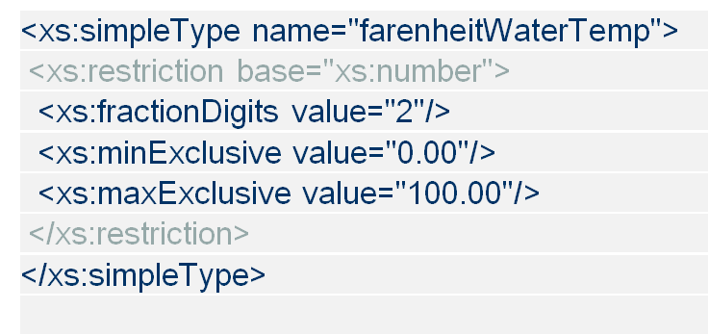
Type Definitions
Simple Type Definition VS. Complex Type Definition
<xs:complexType name="personName">
<xs:sequence>
<xs:element name="title" minOccurs="0"/>
  … …
</xs:sequence>
</xs:complexType>
Notes:
By type definition, we can do type checking using applications, also we can reuse our type definitions. There two kinds of type definition, simple and complex. The former can be used to declare attributes and elements without sub element, while the latter can only be used to declare elements with sub elements.

Slide 95
XML Schema = Rules
XML Schemas is all about expressing rules:
  rules about what data is allowed
  rules about how the data must be organized
  rules about the relationships between data

Slide 96
Example: Shipping Order
<?xml version="1.0"?>
<shipOrder>
<shipTo>
<name>Svendson</name>
<street>Oslo St</street>
<address>400 Main</address>
<country>Norway</country>
</shipTo>
<items>
<item>
<title>Wheel</title>
<quantity>1</quantity>
<price>10.90</price>
</item>
<item>
<title>Cam</title>
<quantity>1</quantity>
<price>9.90</price>
</item>
</items>
</shipOrder>

Slide 97
Validation Rules
<?xml version="1.0"?>
<shipOrder>
<shipTo>
<name>Svendson</name>
<street>Oslo St</street>
<address>400 Main</address>
<country>Norway</country>
</shipTo>
<items>
<item>
<title>Wheel</title>
<quantity>1</quantity>
<price>10.90</price>
</item>
<item>
<title>Cam</title>
<quantity>1</quantity>
<price>9.90</price>
</item>
</items>
</shipOrder>
Validate the XML
document against
the XML Schema
XML Schema
Rule 1: A shipping order has address and items.
Rule 2: There is only one shipping address.
Rule 3: Shipping address has only name, street, address and country.
Rule 4: There is at least one item.
Rule 5: each item must have title, quantity and price.

Slide 98
Example: Shipping Order
<?xml version="1.0"?>
<shipOrder>
<shipTo>
<name>Svendson</name>
<street>Oslo St</street>
<address>400 Main</address>
<country>Norway</country>
</shipTo>
<items>
<item>
<title>Wheel</title>
<quantity>1</quantity>
<price>10.90</price>
</item>
<item>
<title>Cam</title>
<quantity>1</quantity>
<price>9.90</price>
</item>
</items>
</shipOrder>
Shipping Address
Shipping
Order
1st Item’s details
Items to
be shipped
2nd Item’s details

Slide 99
XML Schema for Shipping Order
<xsd:schema xmlns:xsd=http://www.w3.org/1999/XMLSchema>
<xsd:element name="shipOrder" type="order"/>
<xsd:complexType name="order">
<xsd:element name="shipTo" type="shipAddress"/>
<xsd:element name="items" type="cdItems"/>
</xsd:complexType>
<xsd:complexType name="shipAddress">
<xsd:element name="name“ type="xsd:string"/>
<xsd:element name="street" type="xsd:string"/>
<xsd:element name="address" type="xsd:string"/>
<xsd:element name="country" type="xsd:string"/>
</xsd:complexType>

Slide 100
XML Schema - Shipping Order (continued)
<xsd:complexType name="cdItems">
<xsd:element name="item" minOccurs="0"
maxOccurs="unbounded" type="cdItem"/>
</xsd:complexType>
<xsd:complexType name="cdItem">
<xsd:element name="title" type="xsd:string"/>
<xsd:element name="quantity“ type="xsd:positiveInteger"/>
<xsd:element name="price" type="xsd:decimal"/>
</xsd:complexType>
</xsd:schema>

Slide 101
XML Schema - Summary
A flexible and powerful schema language
Syntax is XML itself
Variety of data types and ability to extend type system
Variety of data “facets” and “patterns” to impose domain constraints
Can define advanced constraints such as “primary key” and “referential integrity”

